Slide 1
Chapter 5:
Algorithms
Computer Science: An Overview
Eleventh Edition
by
J. Glenn Brookshear

Slide 2
Chapter 5: Algorithms
5.1 The Concept of an Algorithm
5.2 Algorithm Representation
5.3 Algorithm Discovery
5.4 Iterative Structures
5.5 Recursive Structures
5.6 Efficiency and Correctness
0-<number>

Slide 3
Definition of Algorithm
An algorithm is an ordered set of unambiguous, executable steps that defines a terminating process.
0-<number>

Slide 4
Algorithm Representation
Requires well-defined primitives
A collection of primitives constitutes a programming language.
0-<number>

Slide 5
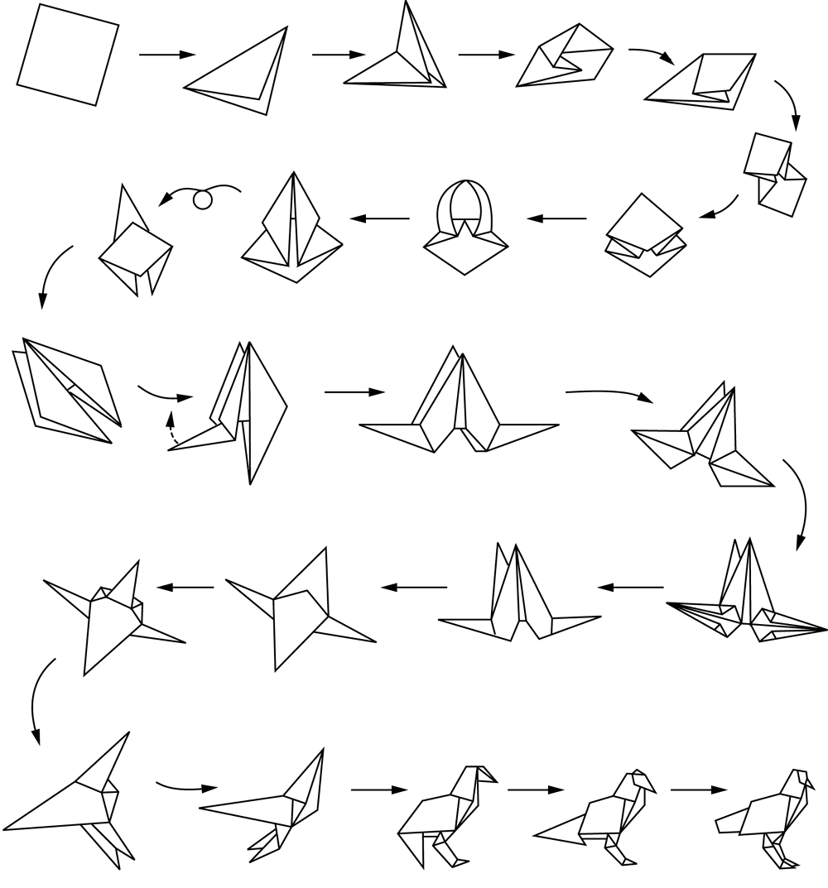
Figure 5.2 Folding a bird from a square piece of paper
0-<number>

Slide 6
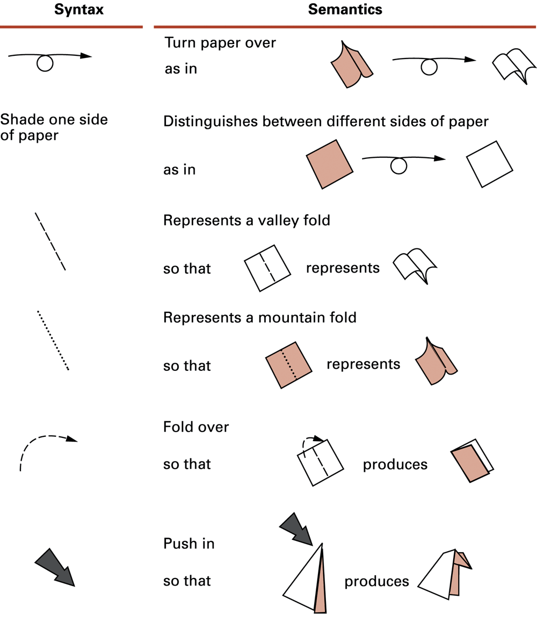
Figure 5.3 Origami primitives
0-<number>

Slide 7
Pseudocode Primitives
Assignment
name ← expression
Conditional selection
if condition then action
0-<number>

Slide 8
Pseudocode Primitives (continued)
Repeated execution
while condition do activity
Procedure
procedure name (generic names)
0-<number>

Slide 9
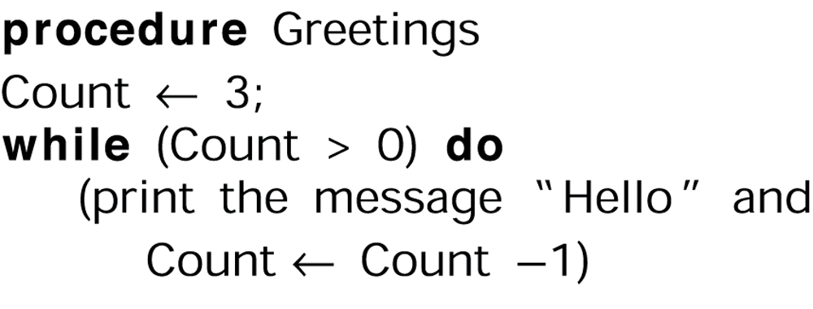
Figure 5.4 The procedure Greetings in pseudocode
0-<number>

Slide 10
Polya’s Problem Solving Steps
1. Understand the problem.
2. Devise a plan for solving the problem.
3. Carry out the plan.
4. Evaluate the solution for accuracy and its potential as a tool for solving other problems.
0-<number>

Slide 11
Getting a Foot in the Door
Try working the problem backwards
Solve an easier related problem
  Relax some of the problem constraints
  Solve pieces of the problem first (bottom up methodology)
Stepwise refinement: Divide the problem into smaller problems (top-down methodology)
0-<number>

Slide 12
Ages of Children Problem
Person A is charged with the task of determining the ages of B’s three children.
  B tells A that the product of the children’s ages is 36.
  A replies that another clue is required.
  B tells A the sum of the children’s ages.
  A replies that another clue is needed.
  B tells A that the oldest child plays the piano.
  A tells B the ages of the three children.
How old are the three children?
0-<number>

Slide 13
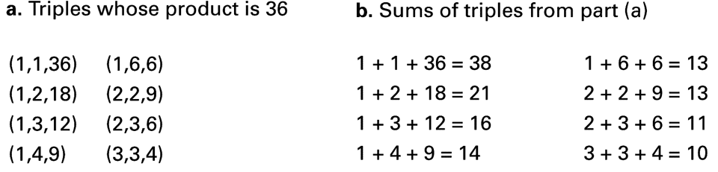
Figure 5.5
0-<number>

Slide 14
Iterative Structures
Pretest loop:
while (condition) do
(loop body)
Posttest loop:
repeat (loop body)
until(condition)
0-<number>

Slide 15
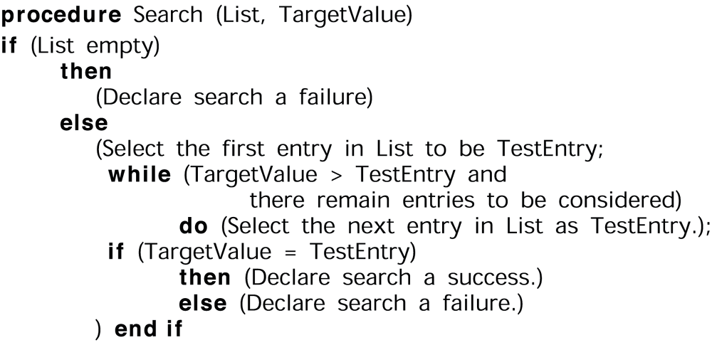
Figure 5.6 The sequential search algorithm in pseudocode
0-<number>

Slide 16
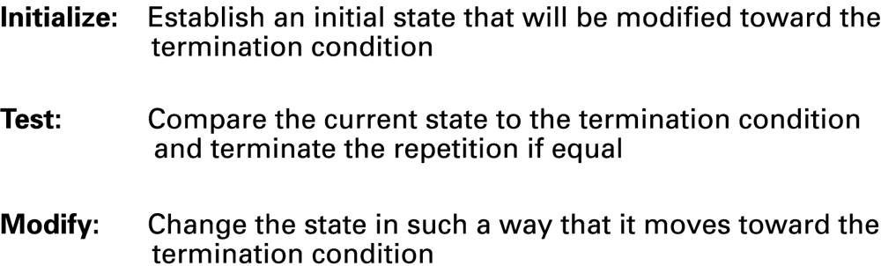
Figure 5.7 Components of repetitive control
0-<number>

Slide 17
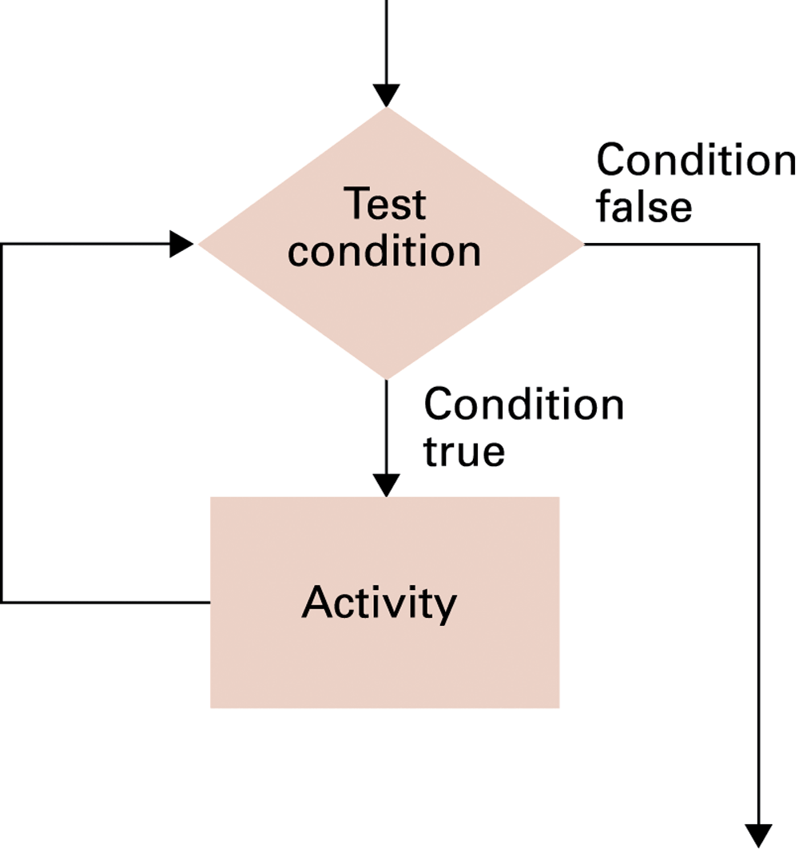
Figure 5.8 The while loop structure
0-<number>

Slide 18
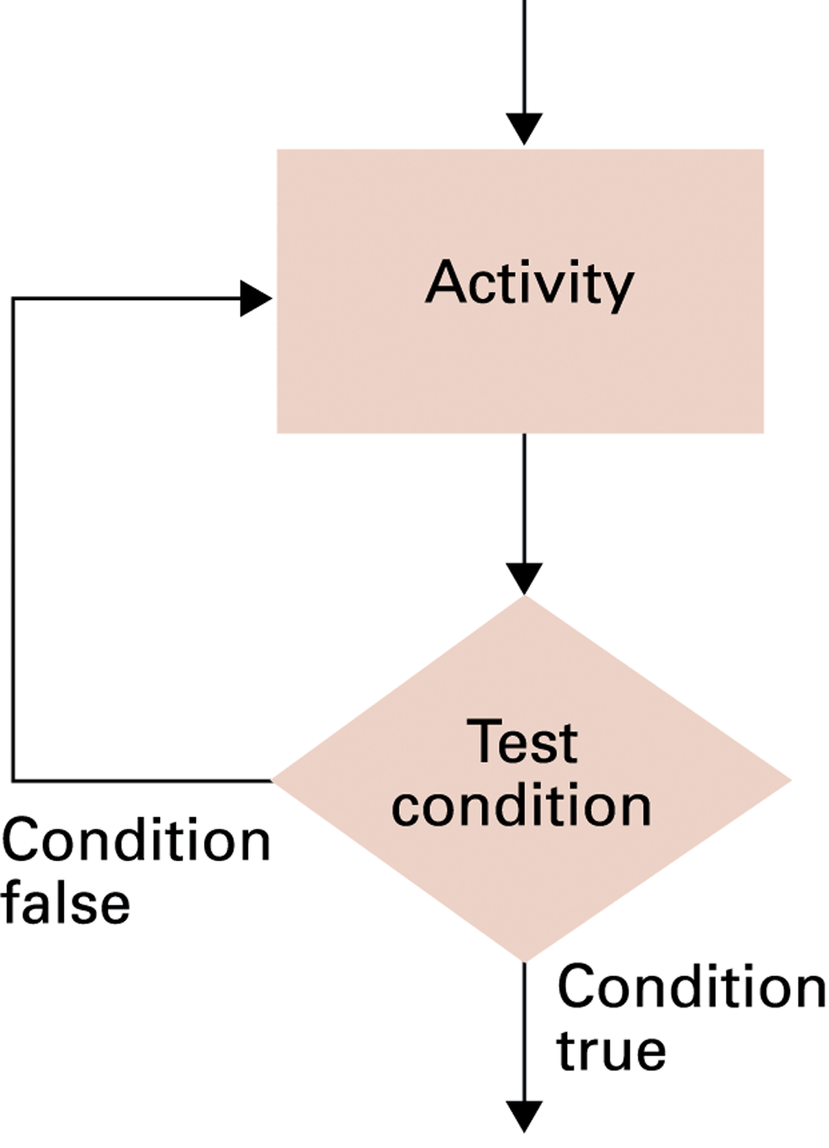
Figure 5.9 The repeat loop structure
0-<number>

Slide 19
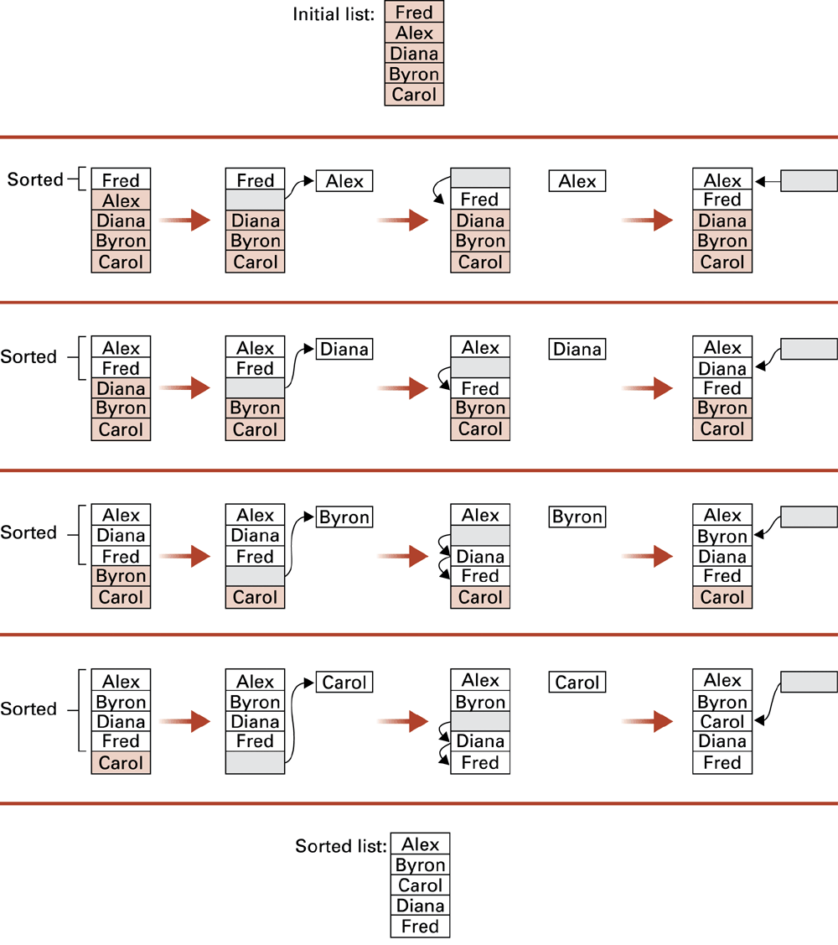
Figure 5.10 Sorting the list Fred, Alex, Diana, Byron, and Carol alphabetically
0-<number>

Slide 20
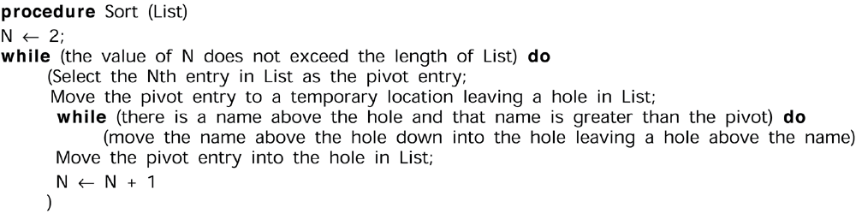
Figure 5.11 The insertion sort algorithm expressed in pseudocode
0-<number>

Slide 21
Recursion
The execution of a procedure leads to another execution of the procedure.
Multiple activations of the procedure are formed, all but one of which are waiting for other activations to complete.
0-<number>

Slide 22
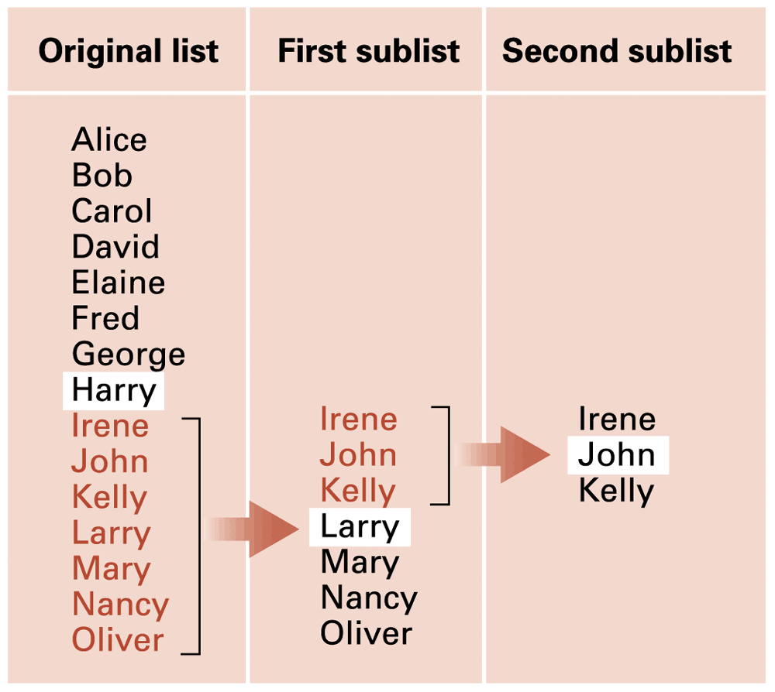
Figure 5.12 Applying our strategy to search a list for the entry John
0-<number>

Slide 23
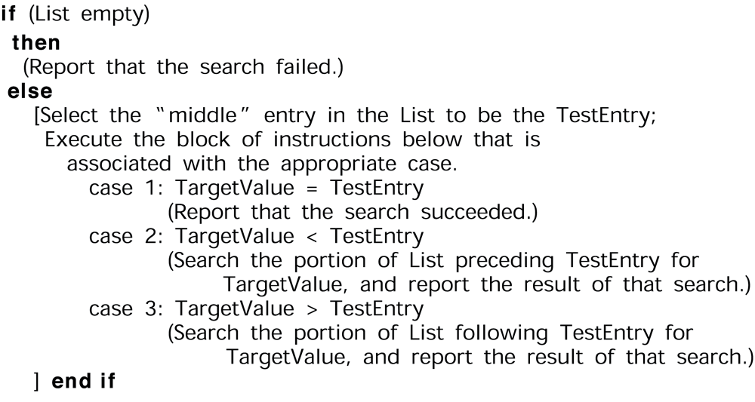
Figure 5.13 A first draft of the binary search technique
0-<number>

Slide 24
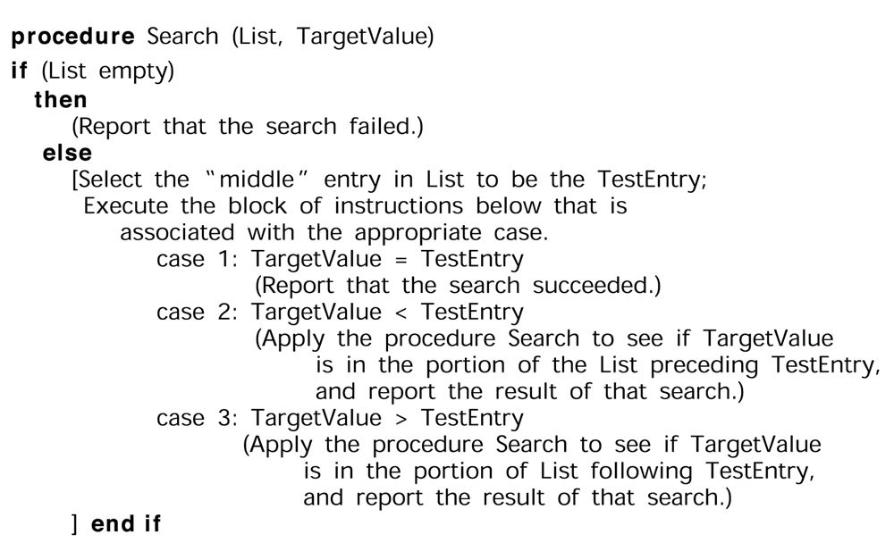
Figure 5.14 The binary search algorithm in pseudocode
0-<number>

Slide 25
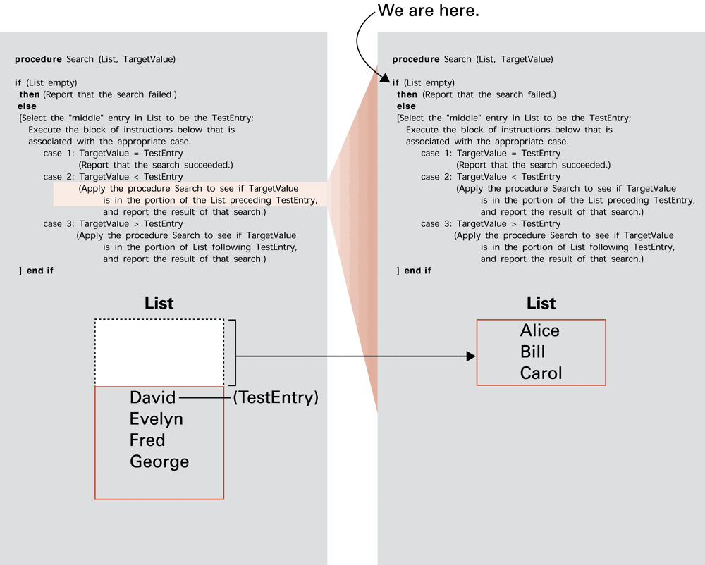
Figure 5.15
0-<number>

Slide 26
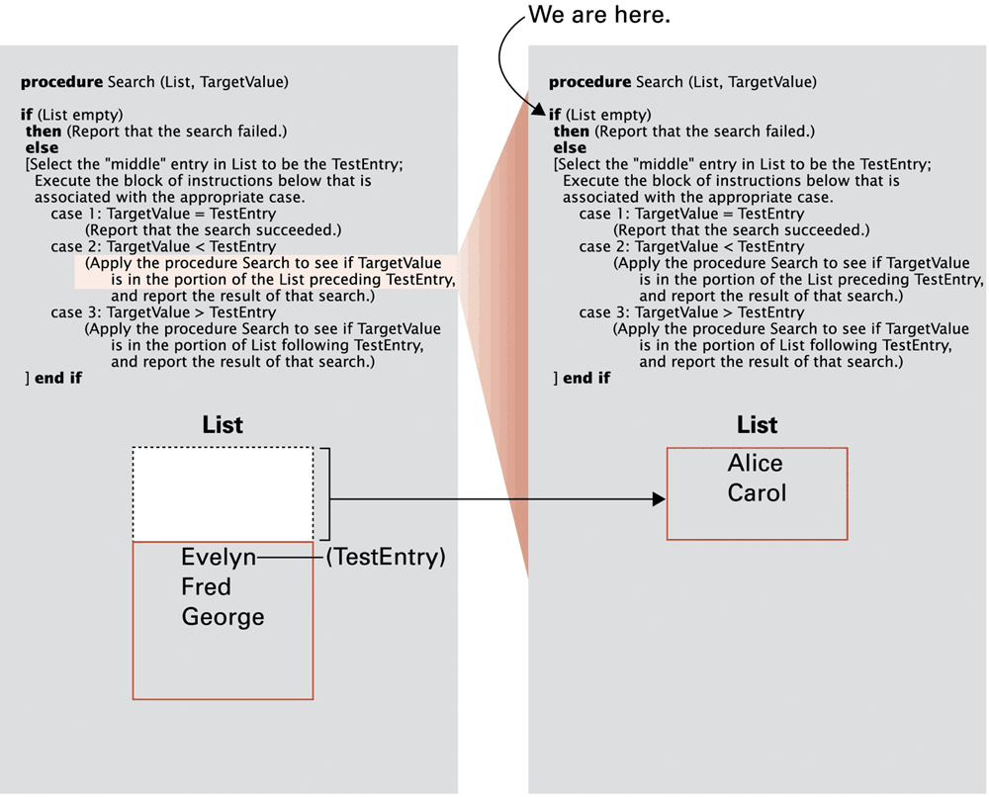
Figure 5.16
0-<number>

Slide 27
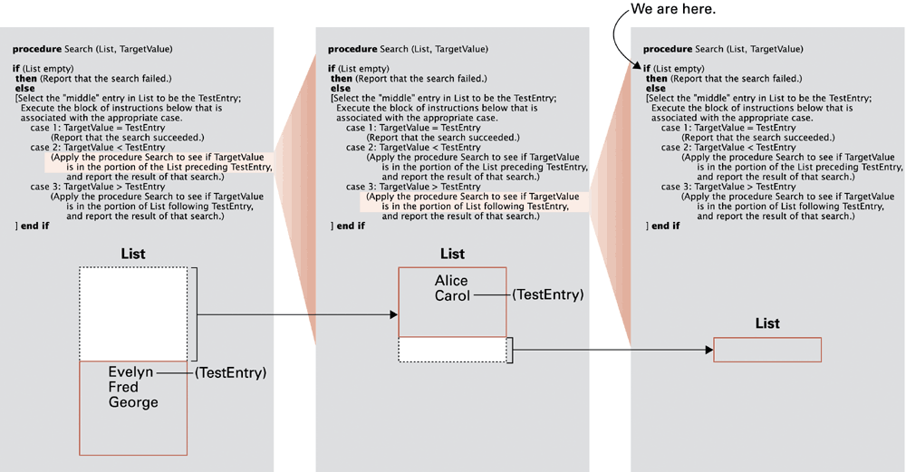
Figure 5.17
0-<number>

Slide 28
Algorithm Efficiency
Measured as number of instructions executed
Big theta notation: Used to represent efficiency classes
  Example: Insertion sort is in Θ(n²)
Best, worst, and average case analysis
0-<number>

Slide 29
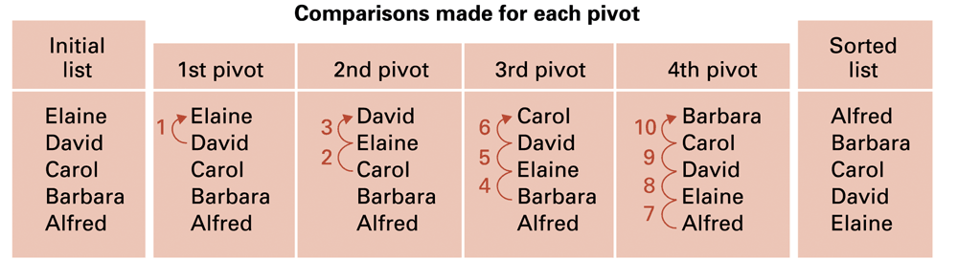
Figure 5.18 Applying the insertion sort in a worst-case situation
0-<number>

Slide 30
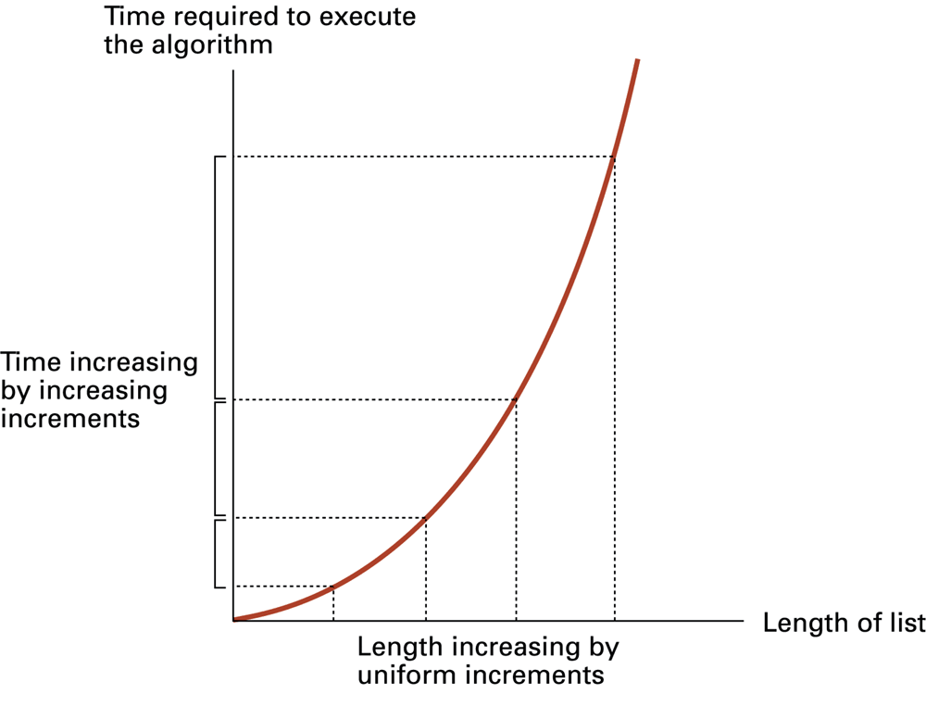
Figure 5.19 Graph of the worst-case analysis of the insertion sort algorithm
0-<number>

Slide 31
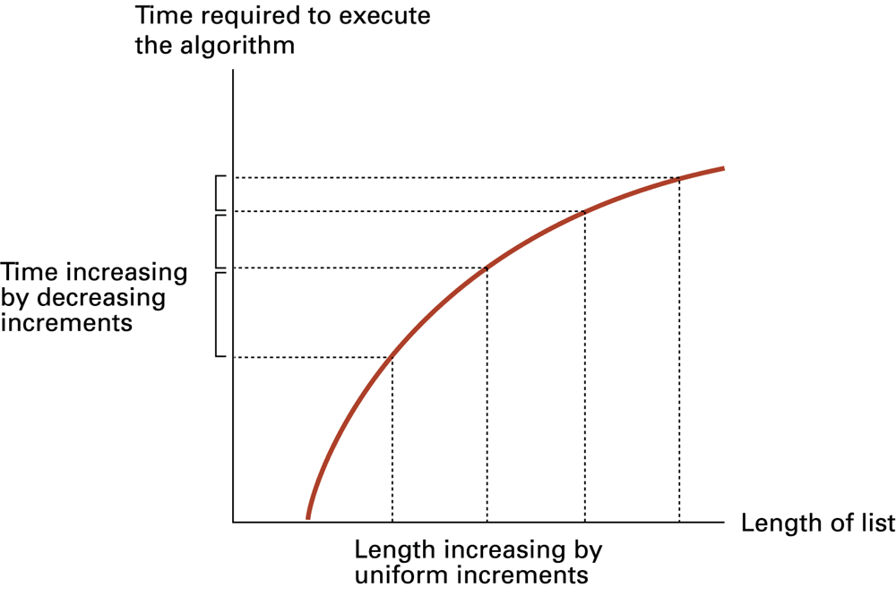
Figure 5.20 Graph of the worst-case analysis of the binary search algorithm
0-<number>

Slide 32
Software Verification
Proof of correctness
  Assertions
    Preconditions
    Loop invariants
Testing
0-<number>

Slide 33
Chain Separating Problem
A traveler has a gold chain of seven links.
He must stay at an isolated hotel for seven nights.
The rent each night consists of one link from the chain.
What is the fewest number of links that must be cut so that the traveler can pay the hotel one link of the chain each morning without paying for lodging in advance?
0-<number>

Slide 34
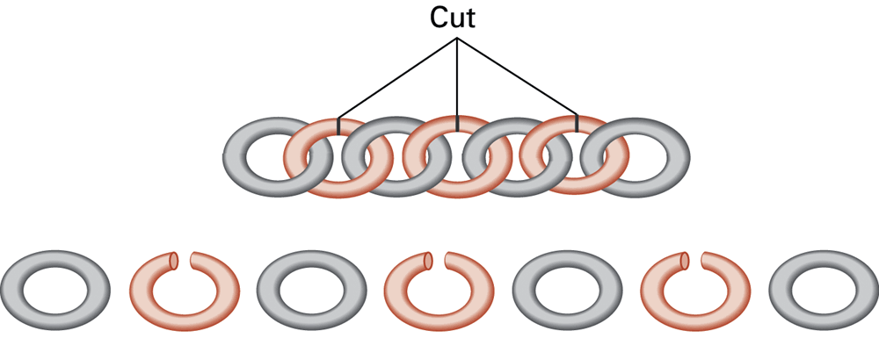
Figure 5.21 Separating the chain using only three cuts
0-<number>

Slide 35
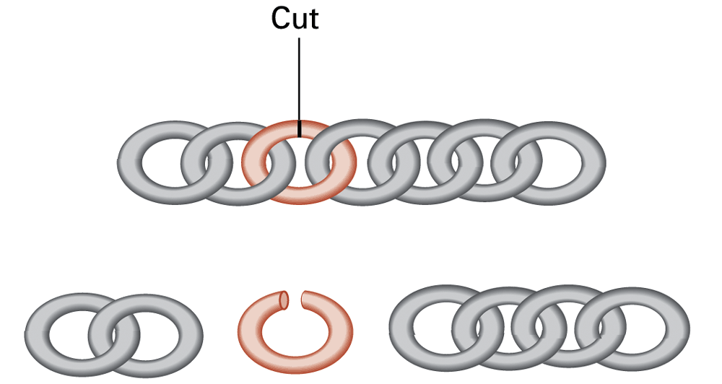
Figure 5.22 Solving the problem with only one cut
0-<number>

Slide 36
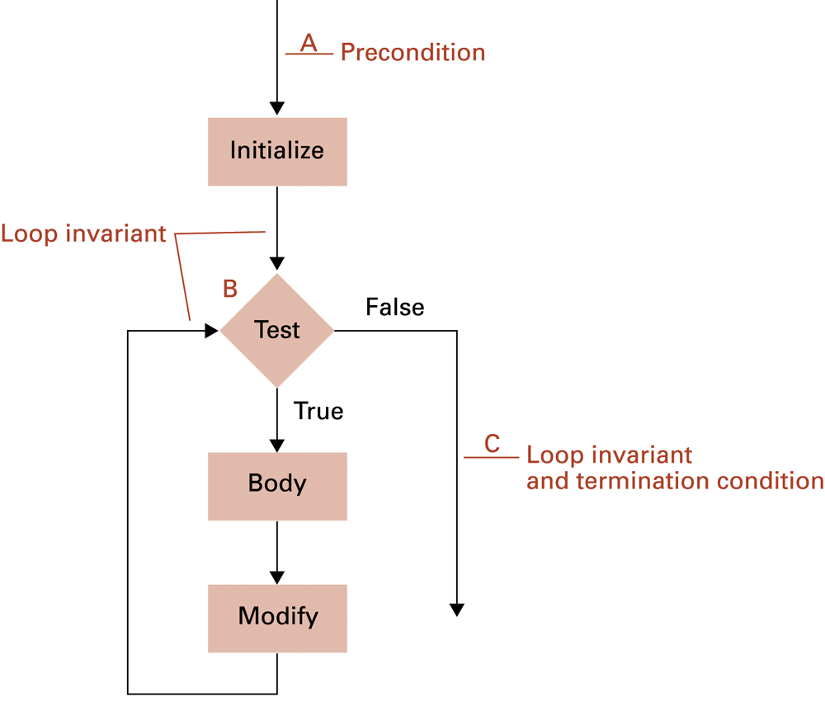
Figure 5.23 The assertions associated with a typical while structure
0-<number>

